Slide 1

BROTHERS IN ACTION AND BE YOURSELF
A TRIBE THAT LOVES
ANGELO CATTANEO

Slide 2
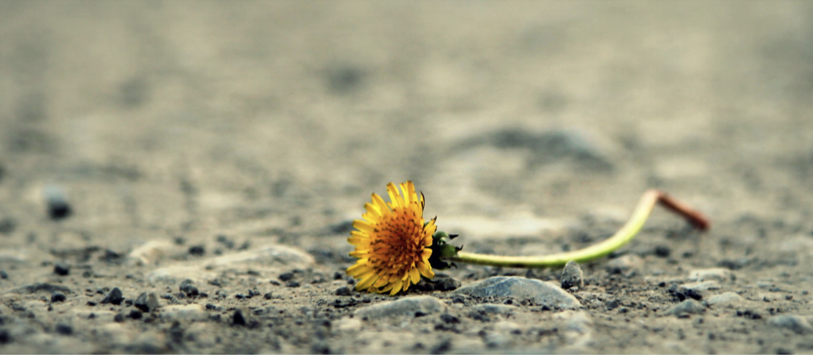
THE BIGGEST FEAR IS NOT THE ONE OF DYING, BUT OF FEELING YOU WASTED YOUR LIFE .
WHAT RESISTANCES DO YOU HAVE TO OVERCOME TO OPEN UP TO WHAT’S NEW?
WHAT YOU REFER TO AS " MY CHARACTER" TODAY, HOW HAS IT FORMED?

Slide 3
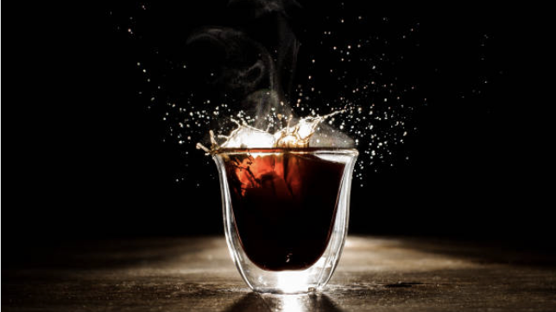
THIS ISYOU

Slide 4

“YOU MUST BE WILLING TO TAKE EVERY PIECE OF LIFE
YOU COME ACROSS AND MANAGE IT
SO THAT IT WORKS FOR YOU AND WITH YOU
AND NOT AGAINST YOU.
THE SECRET RESIDES IN BEING WILLING.
YOUR WILLINGNESS TO MANAGE THEM FOR GOOD INSTEAD OF COMPLAINING OR RESORTING TO EXCUSES
WILL BE REWARDING”.
WAYNE DYER

Slide 5
<
<<<
A TRIBE

Slide 6

A TRIBE
IS A PLACE NOT SIMPLY TO RECEIVE TRAINING, BUT WHERE AN EXCHANGE OF IDEAS, OPINIONS AND ENERGY TAKES PLACE .

Slide 7


A TRIBE IS NOT A TRAINING GROUP THAT REVOLVES AROUND A GUIDE, BUT A SPACE WHERE YOU SEARCH FOR THE "MASTER" IN YOURSELF AND THE PERSON IN "CHARGE" OF THE TRIBE AT THAT MOMENT STIMULATES AND FACILITATES THE CONNECTION OF ALL PARTICIPANTS WITH THEIR INNER GUIDE .

Slide 8

A TRIBE IS A COHESIVE GROUP WHERE PEOPLE SHARE
THE SAME VALUES AND IDEALS.

Slide 9

IN OUR TRIBE EACH MEMBER HAS EQUAL IMPORTANCE AND DIGNITY,
REGARDLESS OF THEIR SOCIAL ROLE IN THE WORLD

Slide 10

WITHIN A TRIBE, EVERYONE LEARNS TO SHOW THEMSELVES FOR WHO THEY ARE, ABANDONING MASKS, STEREOTYPES AND BELIEFS.
AND WHEN THEY DO SO, THEY GIVE THEMSELVES
PERMISSION TO GIVE, ASK FOR AND RECEIVE HELP.

Slide 11
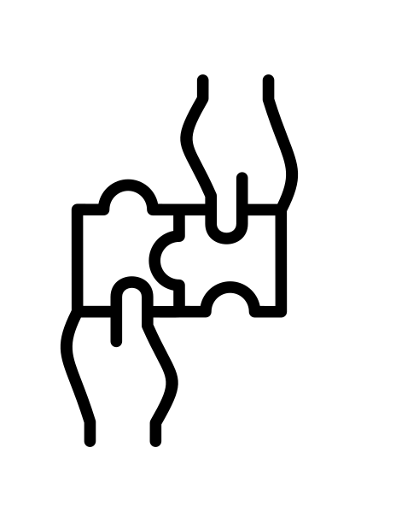
IN A TRIBE AUTHENTIC RELATIONSHIPS AND MEANINGFUL CONNECTIONS ARE CREATED, BASED ON MUTUAL RESPECT AND AWARENESS OF THE ESTABLISHED RULES.

Slide 12

A TRIBE EXISTS APART FROM THE INSTITUTIONAL MOMENTS
WHERE WE ALL COME TOGETHER,
BECAUSE EACH PARTICIPANT IS COMMITTED
TO REDISCOVERING AND AWAKENING WITHIN THEMSELVES
THE PERCEPTION OF BEING LOVE.
LOVE IS THE GLUE OF OUR TRIBE!

Slide 13
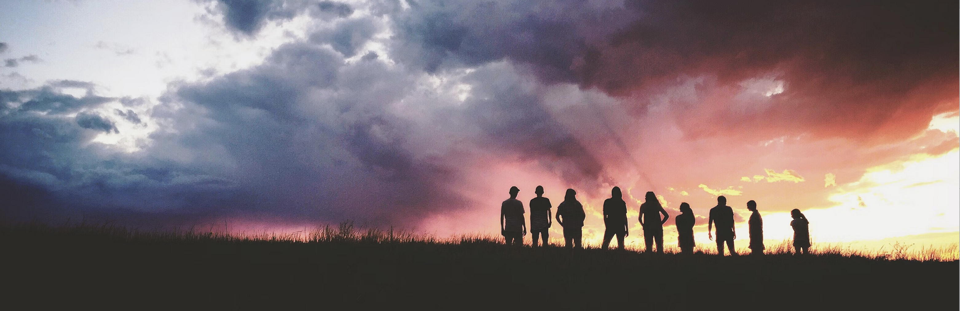
“THE NEXT BUDDHA WILL NOT TAKE THE SHAPE OF A PERSON.
THE NEXT BUDDHA WILL RATHER TAKE THE SHAPE OF A COMMUNITY,
A COMMUNITY THAT PRACTICES LOVING UNDERSTANDING AND KINDNESS ,
A COMMUNITY THAT PRACTICES A CONSCIOUS WAY OF LIVING.
THIS MAY BE THE MOST IMPORTANT THING FOR THE SURVIVAL OF THE EARTH ”
Thich Nhat Hahn

Slide 14
BROTHERS IN ACTION and BE YOURSELF
WE ARE A WONDERFUL TRIBE,
THE FORMER OF MEN AND THE LATTER OF WOMEN
IN WHICH EVERYONE CAN SHOW WHO THEY ARE.
THE GROUP DIMENSION IS AN ADDED VALUE FOR ALL PARTICIPANTS
TO LET GO OF SOME PATTERNS, BE INSPIRED AND OPEN UP TO LOVE.

Slide 15
PURPOSES OF THE JOURNEY TOGETHER
RECOGNIZING AND MANAGING EMOTIONAL SHOCK
TRANSFORMING LIMITING BELIEFS AND FANTASIES PROJECTED INTO THE FUTURE;
REBALANCING CHAKRAS AND DECREASING STRESS
BECOMING AWARE OF ALL INTERNAL OSTACLES AND IMPEDIMENTS
MANAGING INNER DIALOGUE
VALUING HIDDEN CAPACITIES AND STRENGTHS
INCREASING THE ENERGY AT YOUR DISPOSAL
ABILITY TO STAND IN YOUR PERSONAL POWER AND LIVE IN THE PRESENT MOMENT
MANAGEMENT OF EMOTIONS: YOU LEARN HOW NOT TO REGRESS AND NOT TO REACT
EFFECTIVELY COMMUNICATING YOUR NEEDS AND NOT TAKING IT PERSONALLY
FEELING THE BODY AND BEING OPEN TO INSIGHTS
INNER DRIVE FOR LIFE

Slide 16


BROTHERS IN ACTION and BE YOURSELF
3 SESSIONs
ONE TO ONE
DURING THE YEAR.
45 HOURS OF THEORETICAL AND EXPERIENTIAL GROUP WORK IN ONE YEAR.
WE MEET EVERY FORTNIGHT
FROM 9pm TO 11:20pm ON ZOOM

Slide 17

TRY TO GET TO KNOW THE FEAR.
BE CURIOUS

Slide 18


YOU ARE SO SURE YOU ARE FLEEING FROM SOMETHING DANGEROUS
SE STESTE SCAPPANDO DA QUALCOSA DI BELLO?
WHAT IF YOU WERE RUNNING AWAY FROM SOMETHING BEAUTIFUL?

Slide 19

IF YOU WANT TO GET OUT OF SOMETHING YOU HAVE TO GET INTO IT
NOT ALONE THIS TIME!
WHAT DO YOU THINK?

Slide 20
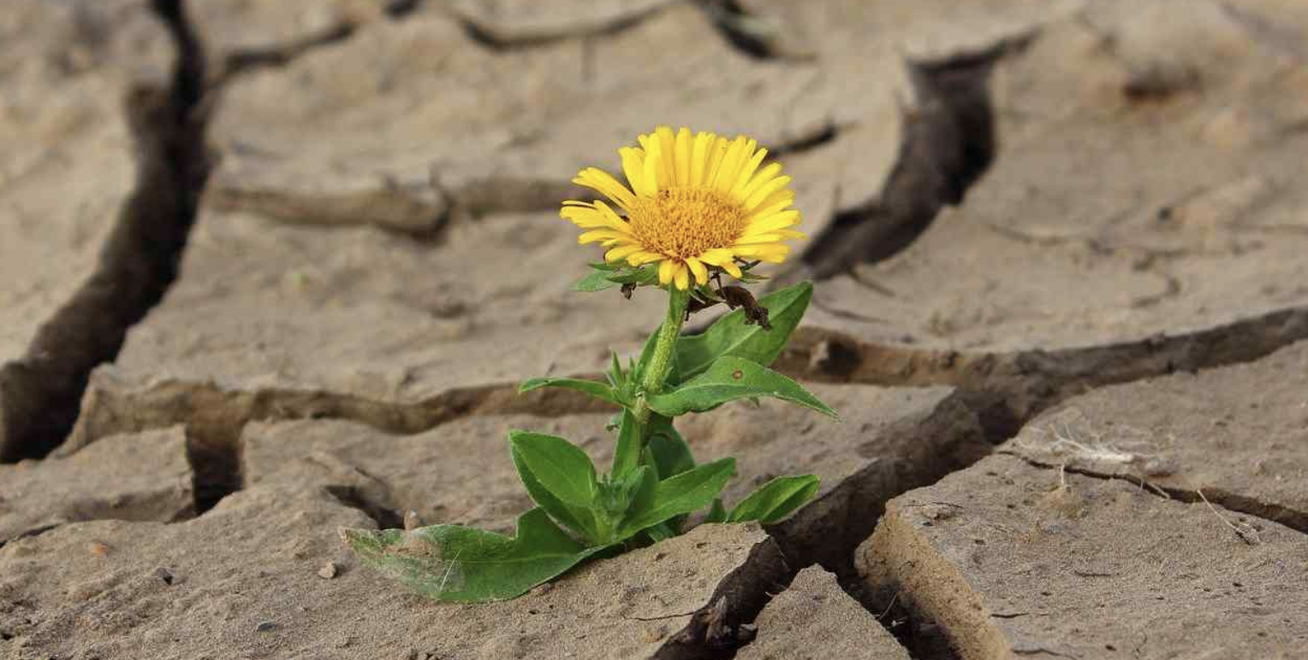
AWAKENING IS THAT MOMENT THAT PRECEDES DOUBT
AWAKENING IS THE POINT THAT PRECEDES DOUBT

Slide 21
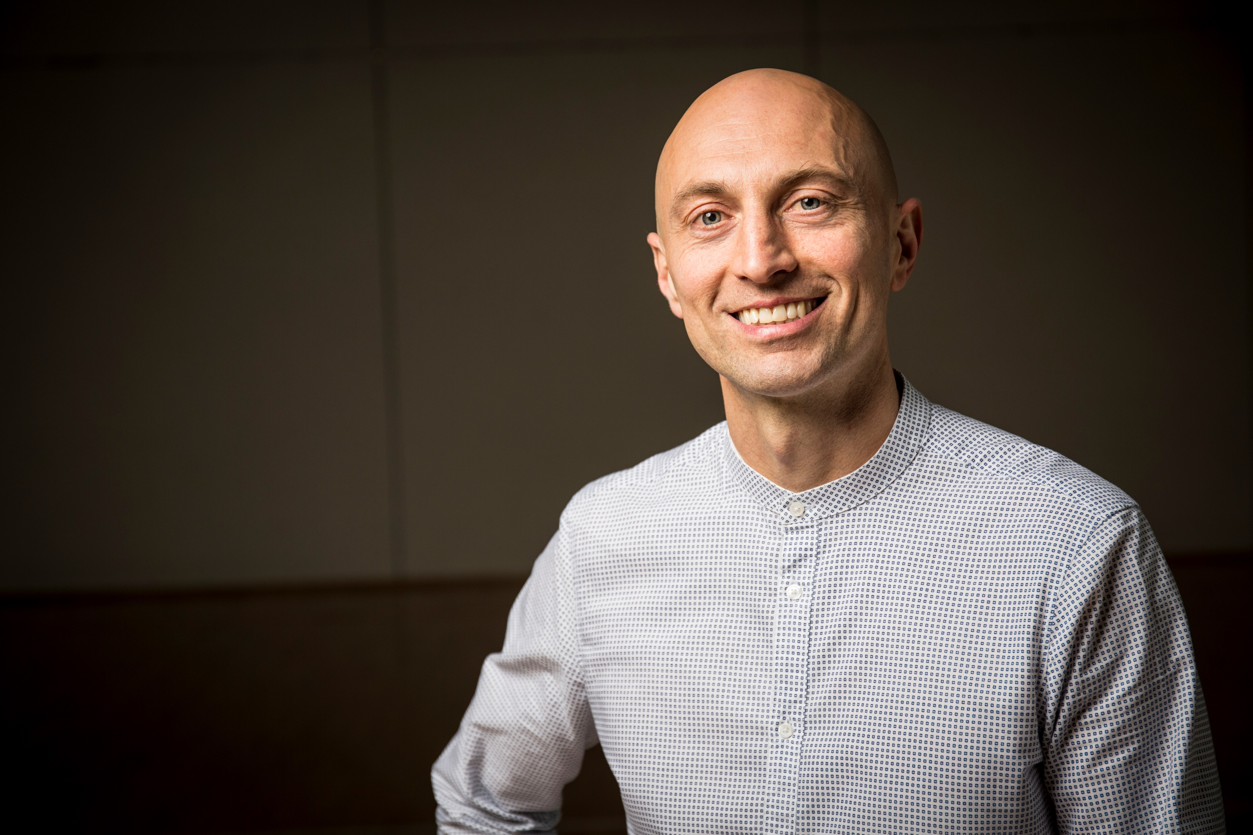
ANGELO CATTANEO
FOUNDER OF THE GROUPS BROTHERS IN ACTION AND BE YOURSELF
www.joytrainer.it - angelo@joytrainer.it - 333.7317074

